Slide 1
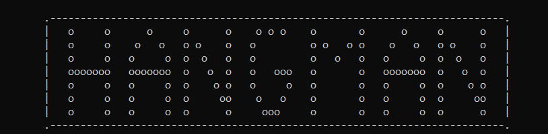
HANGMAN
GAME
SUBMITTED TO-:
SARABJIT SIR
SUBMITTED BY-:
PALVASHA BANSAL CO21347
KARTIK CO21333

Slide 2
WHAT HANGMAN DOES?
HANGMAN is a word guessing game which gives 5 chances to the user to the guess the word given.
The word generated at random is accompanied by a hint which helps the user to understand to which category the word belongs to.
If the user guesses the word before the chances are exhausted then the user wins.

Slide 3
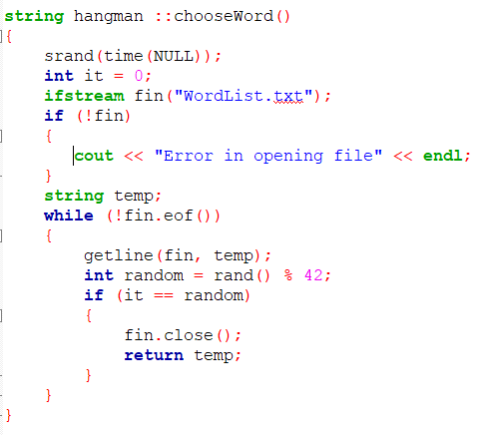
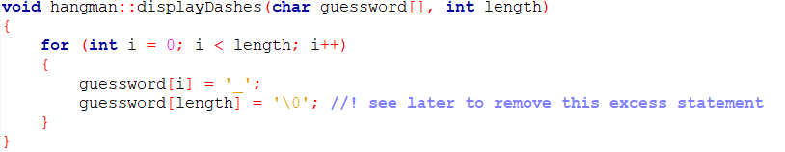
HOW HANGMAN WORKS?
PART 1
The program generates a random number and selects the corresponding array element. [srand() function and file handling is used]
The word is displayed to the user using dashes.
Further input of an alphabet is required from the user in order to guess the word.

Slide 4
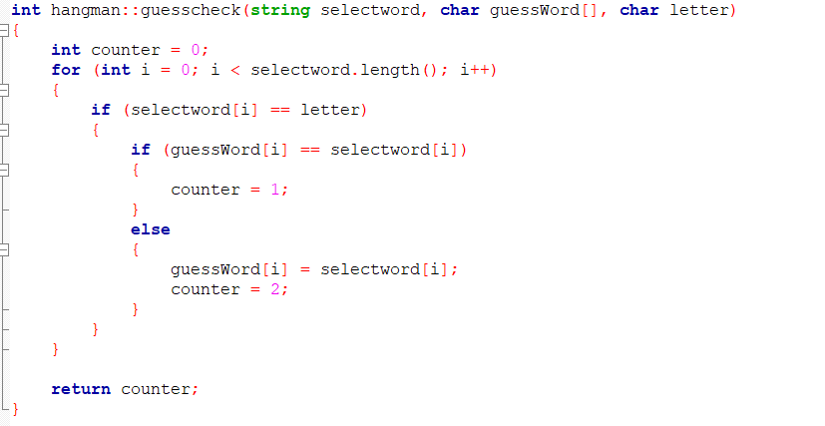
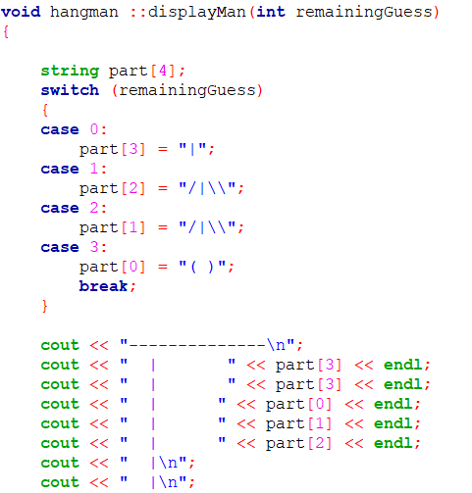
PART 2
4. If the user guesses the right alphabet then she/he can further input another alphabet such that the number of tries remain intact otherwise number of tries are reduced by one.

Slide 5
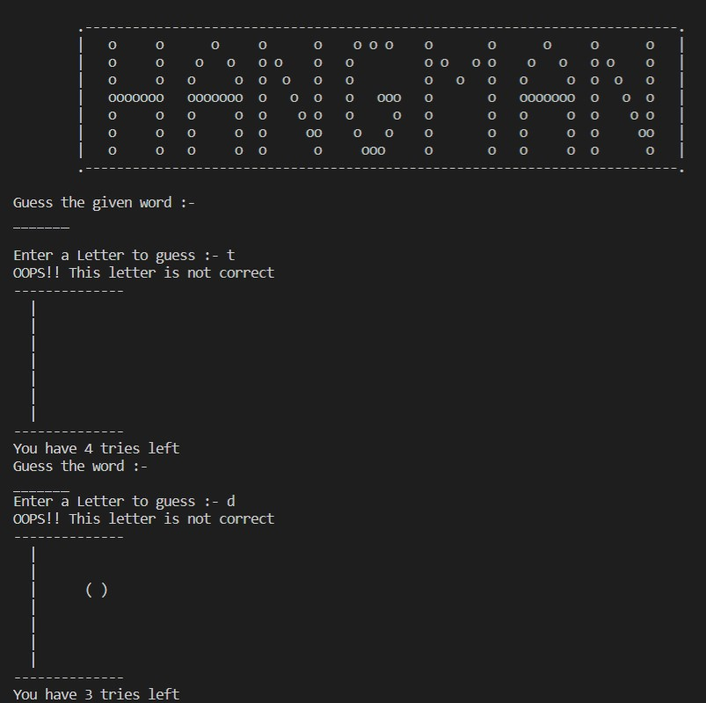
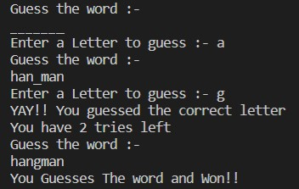
OUTPUT WHEN THE USER WINS :-
1)
2)

Slide 6
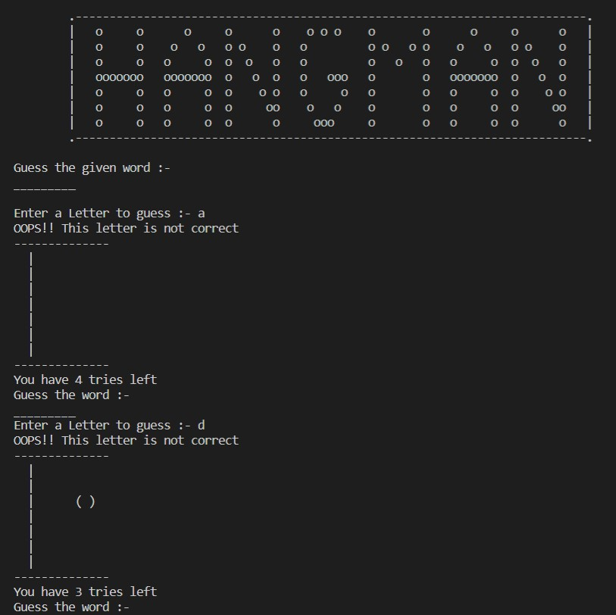
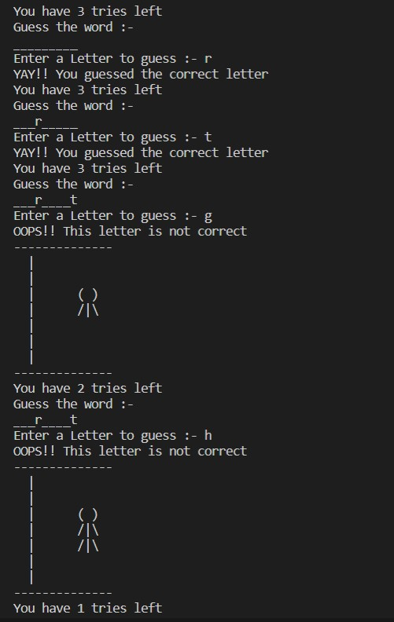
OUTPUT WHEN USER LOSES :-
1)
2)

Slide 7
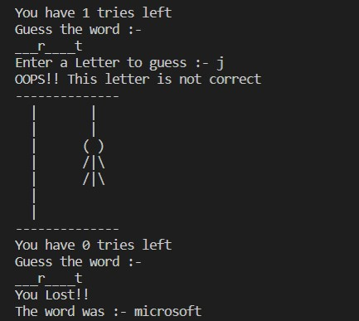
3)

Slide 8
WHAT MORE CAN BE DONE?
The words that the program selects from can be increased by using data structures.
User interface can be made more appealing and user friendly.

Slide 9
THANK YOU!!

